Slide 1
Topic 8
The morphological structure of the generative organs of plants
al-Farabi Ka akh National University
Faculty of Biology and biotechnology
Department of Biodiversity and Bioresources

Slide 2
Flowering Plants
The flowering plants, or angiosperms (also called Angiospermae, Magnoliophyta, or Anthophyta), are a monophyletic group currently thought to be the sister group to the gymnosperms. Angiosperms are by far the most numerous, diverse, and “successful” existing plant group, containing well over 95% of all land plant species alive today.
Actually, flowering plants grow in every habitable region and are dominant in some aquatic and most terrestrial ecosystems, the notable exception to the latter being coniferous forests.
Angiosperms comprise the great bulk of our economically important plants, including our most valuable food crops.

Slide 3
Morphology of seeds

Slide 4
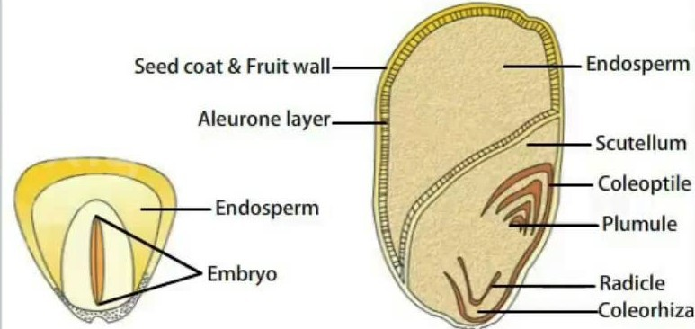
On the basis of the number of cotyledons in the embryo the angiosperms have been divided into two large groups:
  Dicotyledons, having embryos with two cotyledons, and
  Monocotyledons, with only one cotyledon.
Monocots, such as corn, have one cotyledon, called the scutellum; it channels nutrition to the growing embryo. As in dicotyledons, the embryo axis of monocotyledons possesses a shoot tip, plumule, enclosed in a sheath called coleoptile and a root tip, radicle, enclosed in coleorhiza. In a monocotyledonous seed, the endosperm is covered by a proteinous layer called aleurone layer. The majority of the monocotyledonous seeds are albuminous seeds i.e., they have thick, swollen endosperms for nourishment. The endosperm is not completely consumed during embryo development.

Slide 5
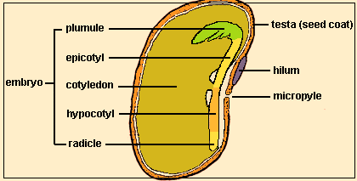
The vital part of a seed is an embryo. It represents the dormant future plant that remains enclosed within the seed coat. Embryo consists of an embryo axis or tigellum and cotyledons.
The embryo axis consists of plumule, epicotyl, cotyledonary node,
hypocotyle and radicle.
Plumule represents the embryonic shoot while radicle represents embryonic root.
The embryo axis has a node called cotyledonary node that bears one or two
cotyledons (= seed leaves).
The part of embryo axis between plumule and
cotyledonary node is
a
called epicotyle and
similar region between
cotyledonary node
and called seed food
radicle is
hypocotyle. The
contains reserve
either in cotyledons or in a
special tissue called
Structure of the seed of beans;
endosperms.

Slide 6
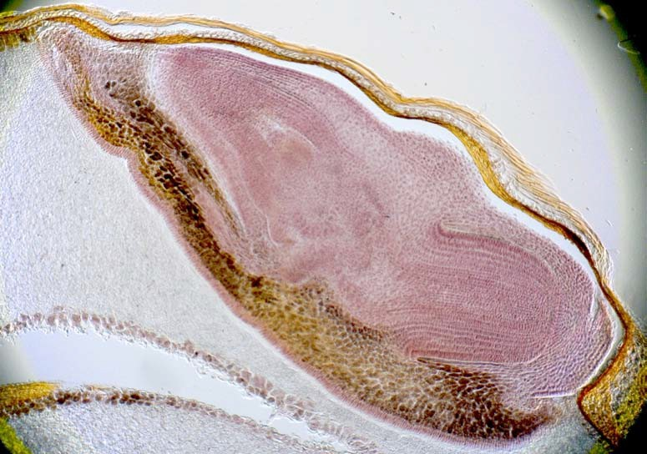
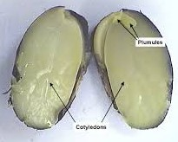
1
The structure of the wheat seed embryo (photo by P.P.Silkin):
- coleoptile;
- plumule;
- radicle;
- koleorhiza;
- scutellum
2
3
4
5

Slide 7
Morphology of Fruits

Slide 8
A fruit is defined as ripened ovary, flower, or whole inflorescence. The origins of the fruit coat and the pericarp (Fig.), which is comprised of the exocarp, mesocarp, and endocarp, are mostly from the wall of the pistil.
Fruits can be simple, multiple, or compound. Simple fruits come from a single pistil (like cherry, Prunus). Multiple fruits are formed from many pistils of the same flower (strawberry, Fragaria). A compound fruit (infructescense) would be a pineapple (Ananas) or fig (Ficus) which comes from multiple flowers (inflorescence)

Slide 9
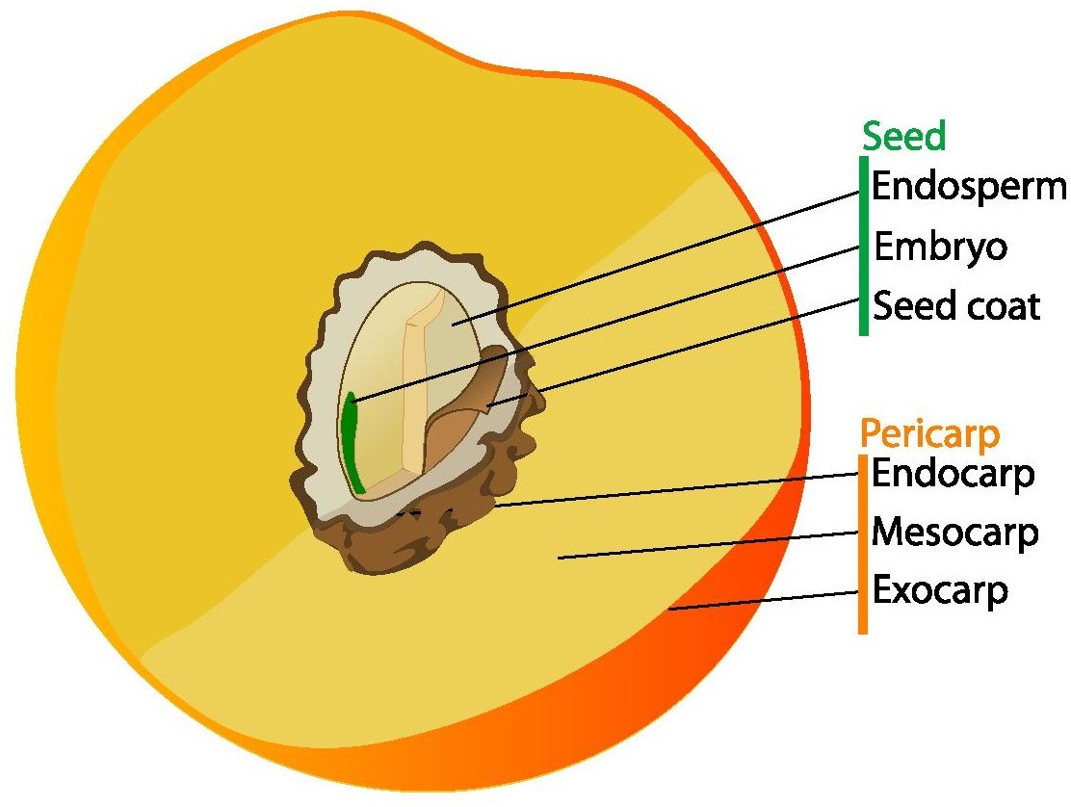
Fig. - Scheme of drupe (e.g., peach) with three levels of
pericarp. Note that pit is essentially endocarp + seed.

Slide 10
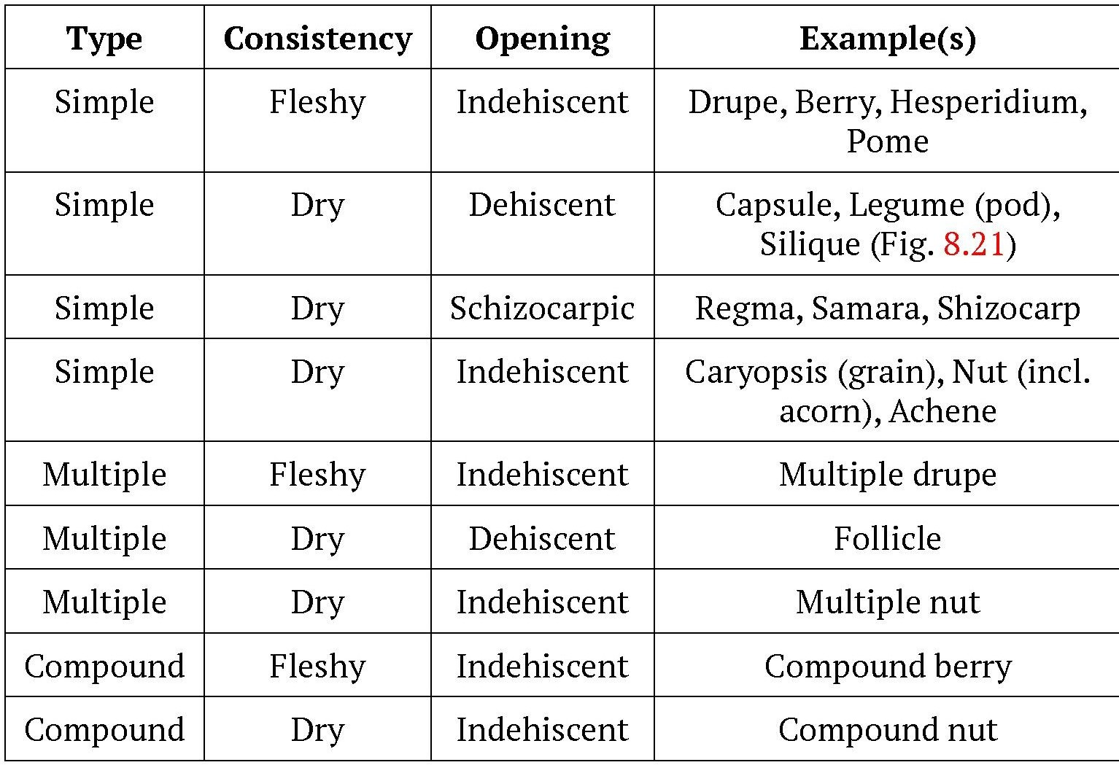

Slide 11
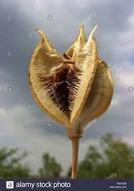
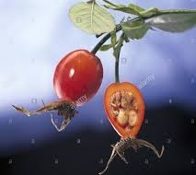
fruit of dog rose
The tulip's fruit is a globose or capsule with a leathery covering ellipsoid to globe shape. Each
ellipsoid and an capsule
The rose hip or rosehip, also called rose haw and rose hep, is the accessory fruit of the rose plant
contains numerous flat, disc-shaped seeds in two rows per chamber

Slide 12
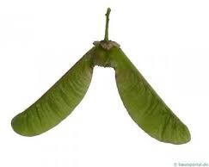
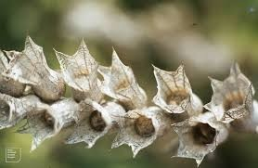
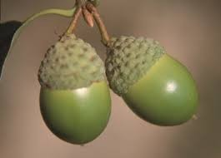
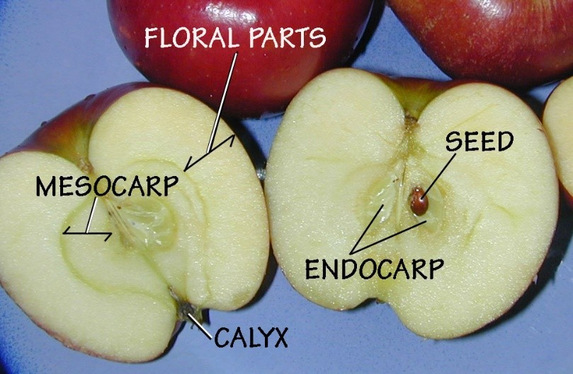
Small, winged a double samara of maple
Henbane, (Hyoscyamus niger), Capsule, dry fruit that opens when ripe.
Acorn of oak (Quercus): The actual nut sits in a cup-shaped involucre of imbricate (overlapping) scales.
Pome of apple

Slide 13
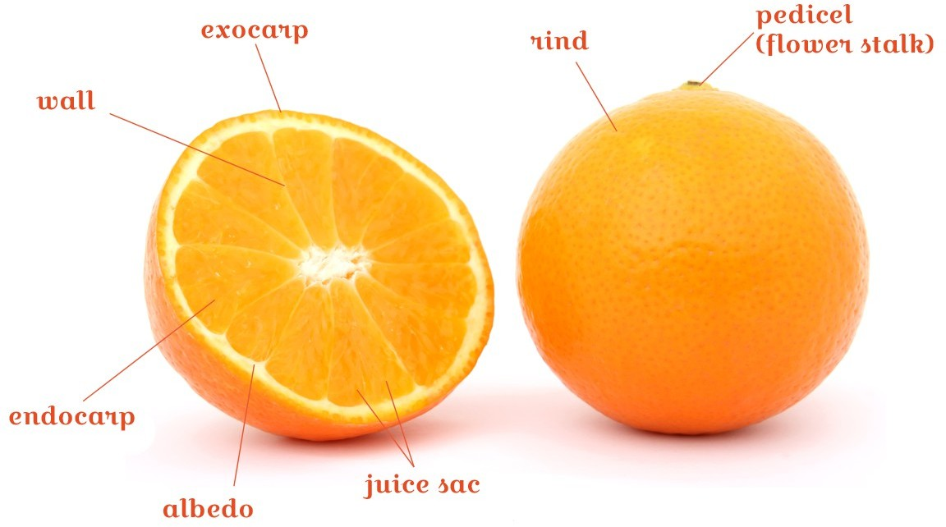
Citrus fruits
Albedo: Inner and soft white skin of the orange located in the rind of the citrus fruits, which contains essential oils, pectin and cellulose.
Endocarp: Inner part of the orange formed by the edible and juicy segments.
Exocarp: Glandular layer of the citrus rind with a yellowish color, which contains the oil vesicles that have very thin and fragile walls and the essential oil allowing the recovery of the exocarp layer in case of abrasion.
Juice sac: Small membranous sac that contains the fruit juice.
Pedicel (flower stalk): Plant stalk which holds the fruit.
Rind: The outer skin of a fruit, such as lemons or oranges.
Wall: Membranous division which divides two internal cavities of an organism (segments).

Slide 14
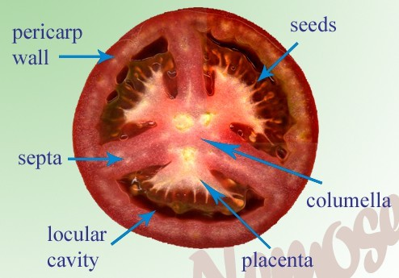
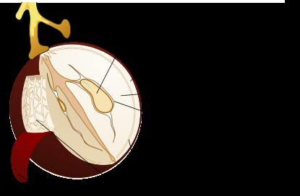
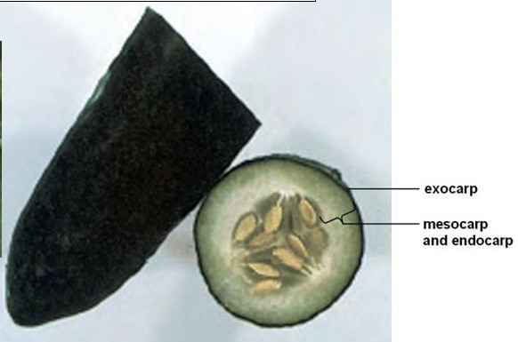
Berry of tomato
Grape berry
Cucumber (Cucumis sativus) fruit is a berry (pepo, a type of berry).

Slide 15
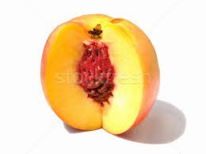
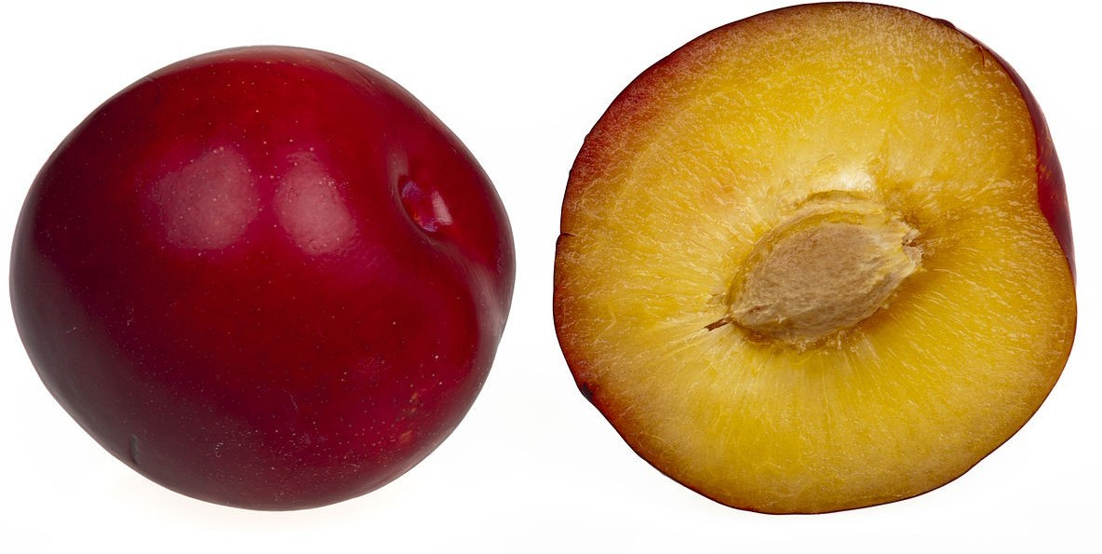
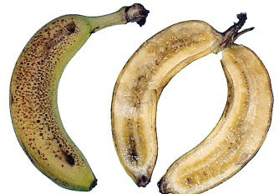
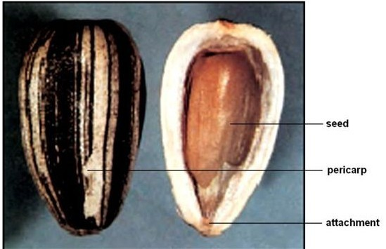
A drupe fruit of peach
A drupe fruit of plum
The mature fruits of banana are a type of
multi-seeded berry, with a leathery outer coat known as an exocarp, and a fleshy, edible interior with numerous seeds embedded.
Achenes of the sunflower (Helianthus annuus).

Slide 16
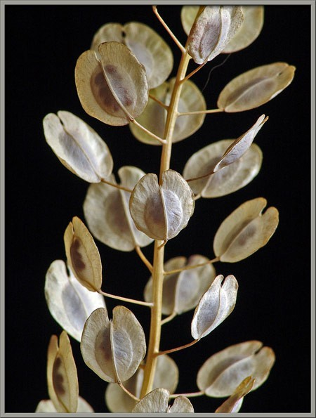
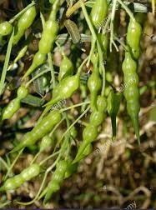
Many-seeded, indehiscent, jointed, siliqua of Wild Radish
Flat, winged pods of penny cress

Slide 17
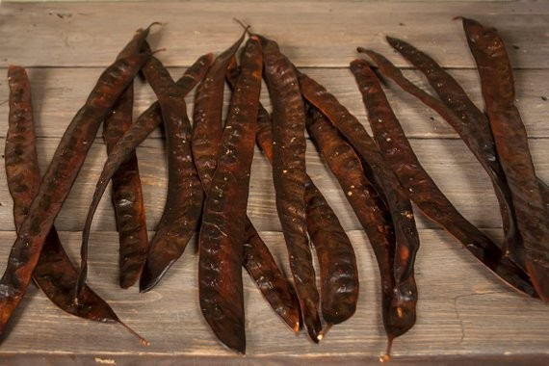
A legume of honey locust

Slide 18
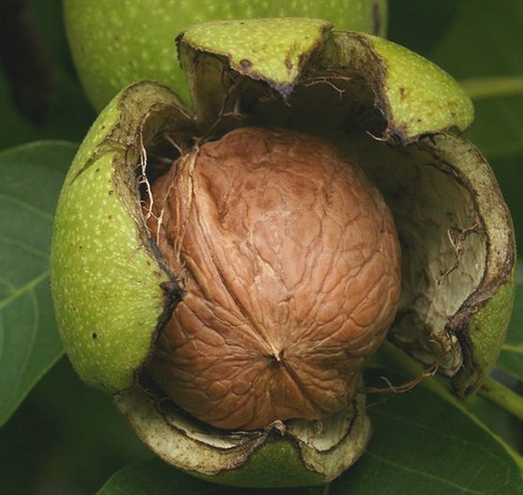
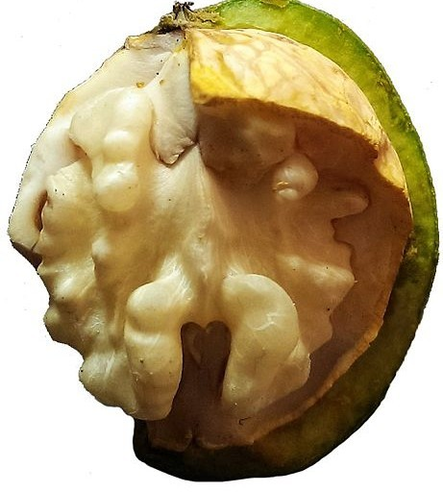
A seudodrupe of walnut (Juglans)

Slide 19
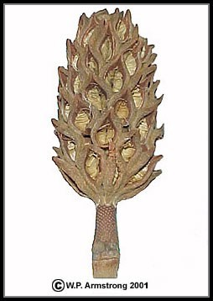
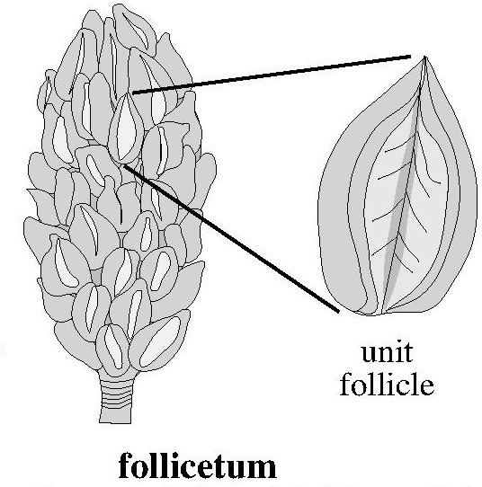
A follicetum (Magnolia)

Slide 20
FLOWER
Perhaps the most obvious distinguishing feature of angiosperms is the flower. A flower can be defined as a modified, determinate shoot system bearing one or more stamens, collectively called the androecium, and/or one or more carpels (making up one or more pistils), collectively called the gynoecium.
Most angiosperm flowers are bisexual (perfect), containing both stamens and carpels, but some are unisexual (imperfect), having only stamens or carpels.
In addition, most (but not all) flowers have a perianth, consisting of modified leaves at the base of the shoot system.

Slide 21
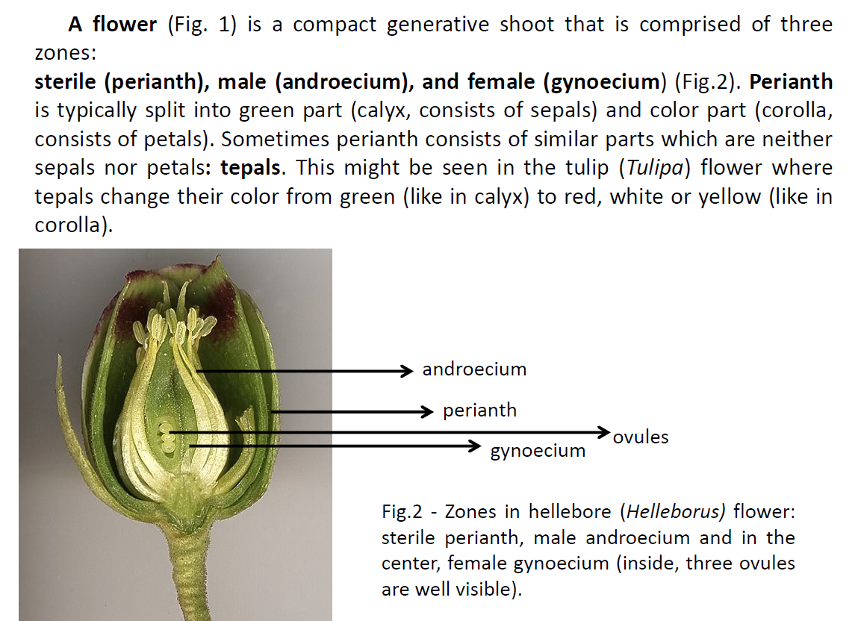

Slide 22
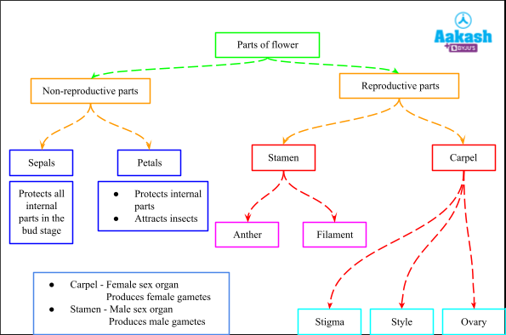

Slide 23
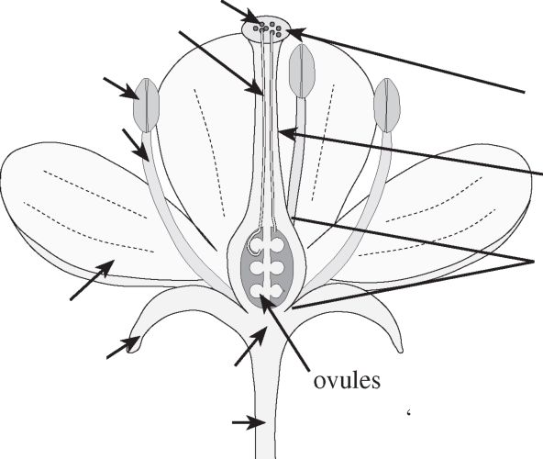
pollen
pollen tubes
stamen (of androecium)
anther
stigma
filament
pistil
^{style}
(of gynoecium)
ovary
petal
(Pistil may consist of one or more carpels)
(of corolla)
perianth
sepal (of calyx)
receptacle
pedicel
(Perianth units termed “tepals” or perianth segments” if similar)
Fig- A typical (diagrammatic) flower, illustrating the parts.

Slide 24
Introduction
A Floral Formula is a very useful “short-hand” method of recording floral structure. The four whorls of the flower are represented by capital letters: K = calyx or sepals, C = corolla or petal (T = perianth, if K and C are indistinguishable), A = androecium or stamens and G = gynoecium or pistil. A number is placed after and slightly below each of these letters to indicate the number of parts in each whorl. If the parts of any whorl are fused, wholly or partially, the figure is enclosed in brackets.

Slide 25
PERIANTH = CALYX + COROLLA
SEPALS small and green, collectively called the CALYX, formula: K
PETALS often large and showy, collectively called the COROLLA, formula: C
TEPALS used when sepals and petals are not distinguishable, they form SIMPLE PERIANTH, formula: P
ANDROECIUM collective term for stamens: formula: A
STAMEN = FILAMENT + ANTHER
ANTHER structure containing pollen grains
FILAMENT structure connecting anther to receptacle

Slide 26
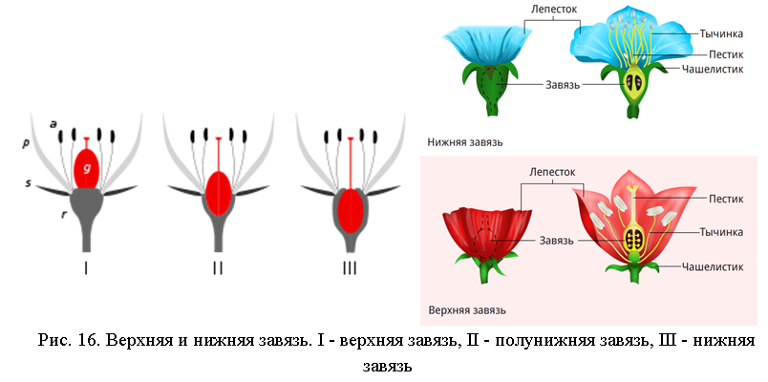
Ovary position is a useful feature in classification. An ovary attached above other floral parts is termed superior; when it lies below the attachment of other floral parts, it is inferior.
If the flower is regular or actinomorphic (i.e. has several planes of symmetry) the formula is prefixed with the sign * ; if irregular or zygomorphic (i.e. has only one plane of symmetry) the formula is prefixed by ↑ . Bisexual flowers have the ♂ and ♀ signs combined.

Slide 27
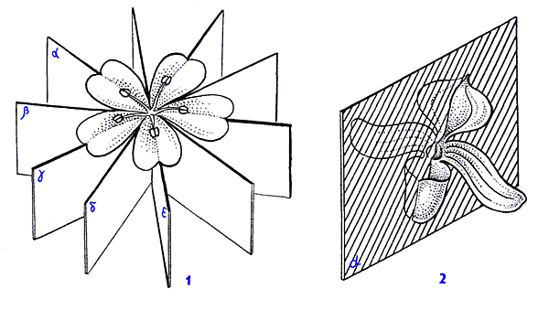

Slide 28
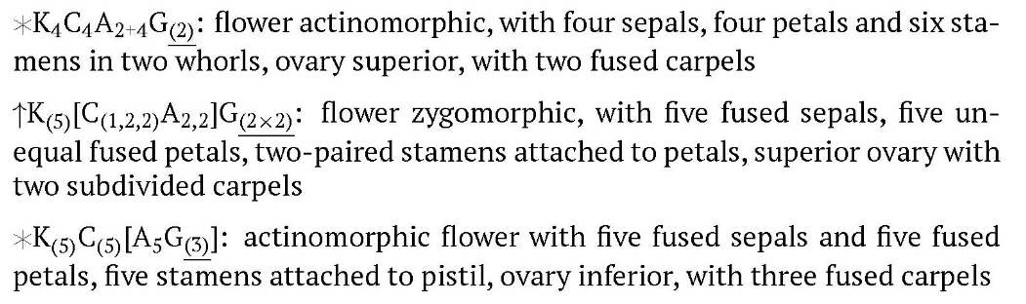
Flower formula
The following signs are used to enrich formulas:
PLUS “+” is used to show different whorls; minus “–” shows variation; “_” = “or”
BRACKETS “[]” and “()” show fusion
COMMA “,” shows inequality of flower parts in one whorl
MULTIPLICATION “” shows splitting
INFINITY “1” shows indefinite number of more than 12 parts

Slide 29
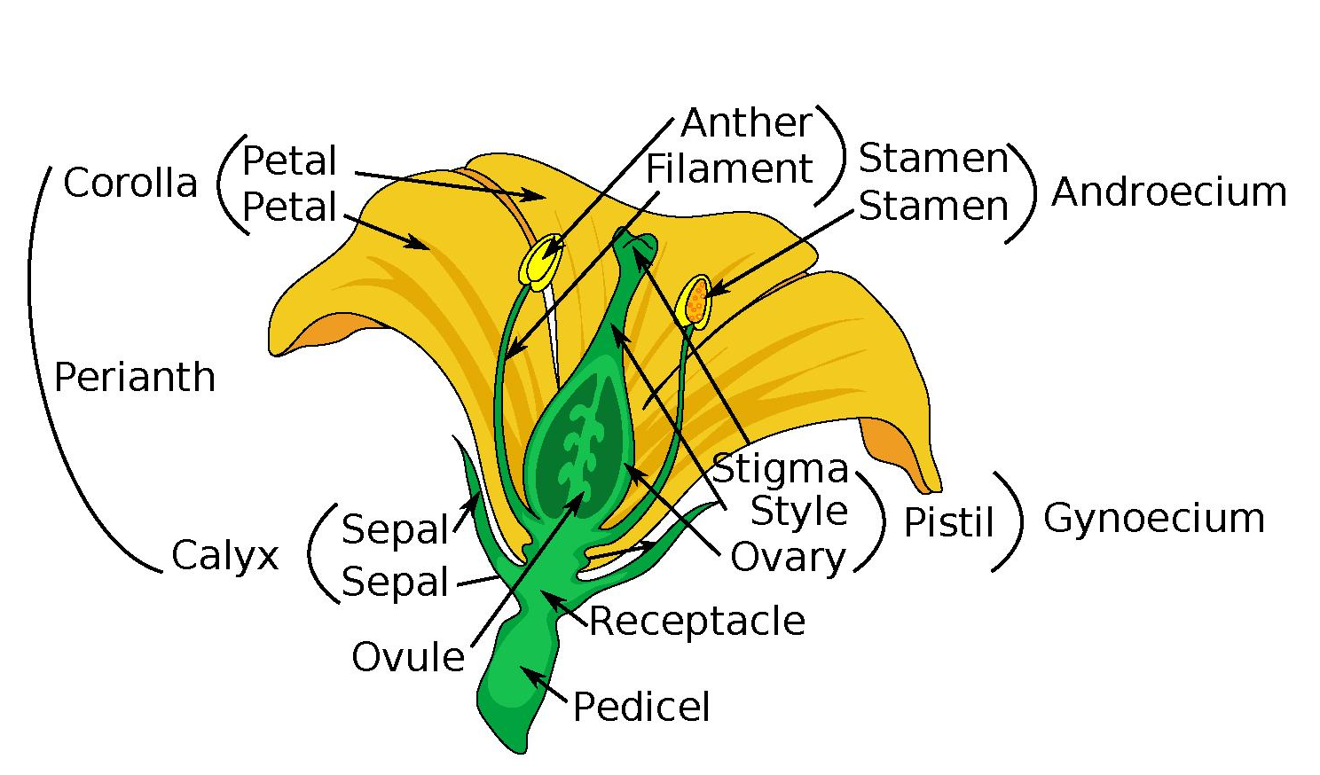
Most important parts of the flower

Slide 30
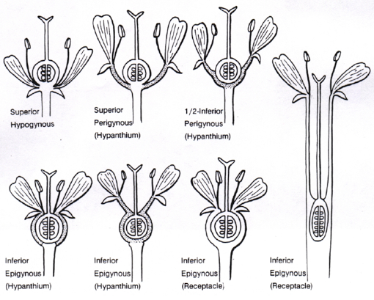
Ovary position

Slide 31
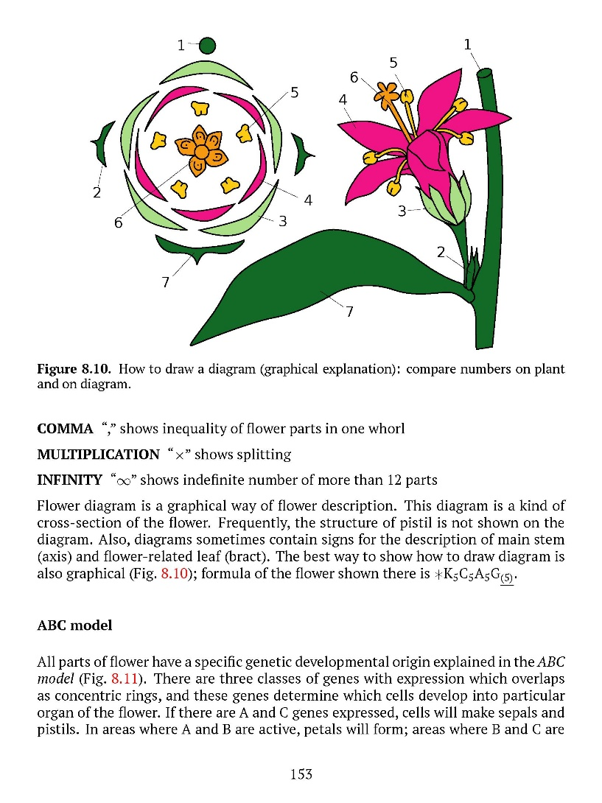
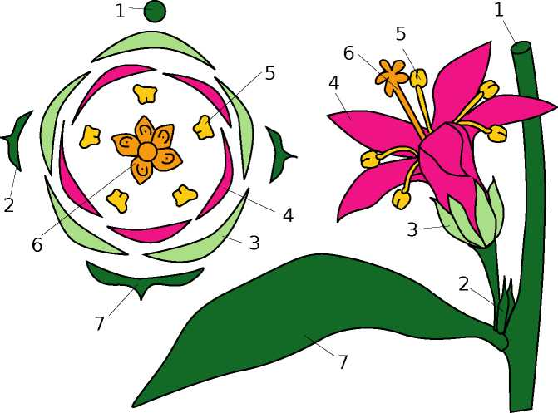
Flower diagram is a graphical way of flower description. This diagram is a kind of cross-section of the flower. Frequently, the structure of pistil is not shown on the diagram. Also, diagrams sometimes contain signs for the description of main stem (axis) and flower-related leaf (bract). The best way to show how to draw diagram is also graphical (Fig.1); formula of the flower shown there is
Fig. 1 - How to draw a diagram (graphical explanation): compare numbers on plant and on diagram.

Slide 32
Traditionally, the flowering plants have been divided into two major groups, or classes,: the Dicots (Magnoliopsida) and the Monocots (Liliopsida).
The table summarizes the major morphological differences between monocots and dicots.
MONOCOTS | DICOTS
Embryo with single cotyledon | Embryo with two cotyledons
Pollen with single furrow or pore | Pollen with three furrows or pores
Flower parts in multiples of three | Flower parts in multiples of four or five
Major leaf veins parallel | Major leaf veins reticulated
Stem vacular bundles scattered | Stem vascular bundles in a ring
Roots are adventitious | Roots develop from radicle
Secondary growth absent | Secondary growth often present

Slide 33
Pollination
The stamens and pistils are directly involved with the production of seed. The stamen bears microsporangia (spore cases) in which are developed numerous microspores (potential pollen grains); the pistil bears ovules, each enclosing an egg cell.
When a microspore germinates, it is known as a pollen grain. When the pollen sacs in a stamen’s anther are ripe, the anther releases them and the pollen is shed. Fertilization can occur only if the pollen grains are transferred from the anther to the stigma of a pistil, a process known as pollination.

Slide 34
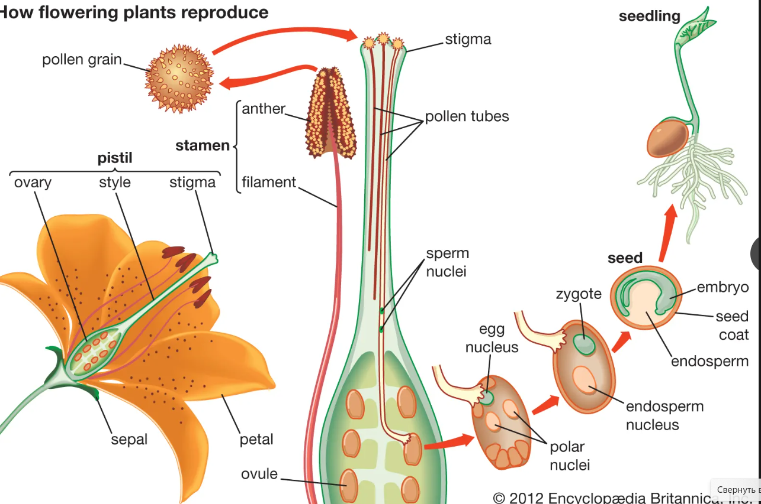

Slide 35
There are two chief kinds of pollination:
(1) self-pollination, the pollination of a stigma by pollen from the same flower or another flower on the same plant;
(2) cross-pollination, the transfer of pollen from the anther of a flower of one plant to the stigma of the flower of another plant of the same species.

Slide 36
After a pollen grain has reached the stigma, it germinates, and a pollen tube protrudes from it. This tube, containing two male gametes (sperms), extends into the ovary and reaches the ovule, discharging its gametes so that one fertilizes the egg cell, which becomes an embryo, and the other joins with two polar nuclei to form the endosperm. (Normally many pollen grains fall on a stigma; they all may germinate, but only one pollen tube enters any one ovule.) Following fertilization, the embryo is on its way to becoming a seed, and at this time the ovary itself enlarges to form the fruit.

Slide 37
Double fertilization
The male gametophyte (pollen grain) is produced in the anther of the stamen. The gynoecium is the female reproductive part composed of carpels or pistils. The female gametophyte (embryo sac) is produced in the ovule enclosed by the ovary.
Before fertilization, the female and male gametes have been produced in the gametophytes (although male gametes are sometimes produced after the pollen grain reaches a flower pistil).

Slide 38
The ovary of a flower contains one or more ovules, which in turn contain the embryo sac. Remember that the embryo sac (haploid female gametophyte) is composed of eight nuclei and seven cells that have specific locations:
Three cells stay near the micropyle, one being the egg cell (female gamete). The other two, called synergid cells, seats one on each side of the egg and are thought to attract the pollen tube.
Other three cells, called the antipodal cells, remain on the opposite side of the micropyle. Their function is unknown and they disintegrate near the time of fertilization.
The remaining two nuclei, called polar nuclei, stay at the center of the large cell. These also participate in the fertilization process.
A pollen grain (haploid male gametophyte) has two cells inside, a tube cell and a generative cell.

Slide 39
The process of double fertilization in flowering plants
Once the pollen grain is transferred from the anther to the stigma of a pistil, the pollen grain germinates, and the tube cell produces a pollen tube. The pollen tube is a long and slender tube that goes all the way down through the style and reaches the interior of the ovary. The generative cell moves through this tube while it divides once by mitosis, producing two haploid cells (two sperms).
Inside the ovary, the pollen tube gets to an ovule and enters through the micropyle (an opening in the integuments or layers that surrounds the embryo sac). The two sperm cells are discharged into the embryo sac. One sperm fertilizes the egg cell, producing a diploid zygote. The other sperm fuses with the two polar nuclei, resulting in a triploid cell. Hence, a double fertilization occurs in angiosperms.

Slide 40
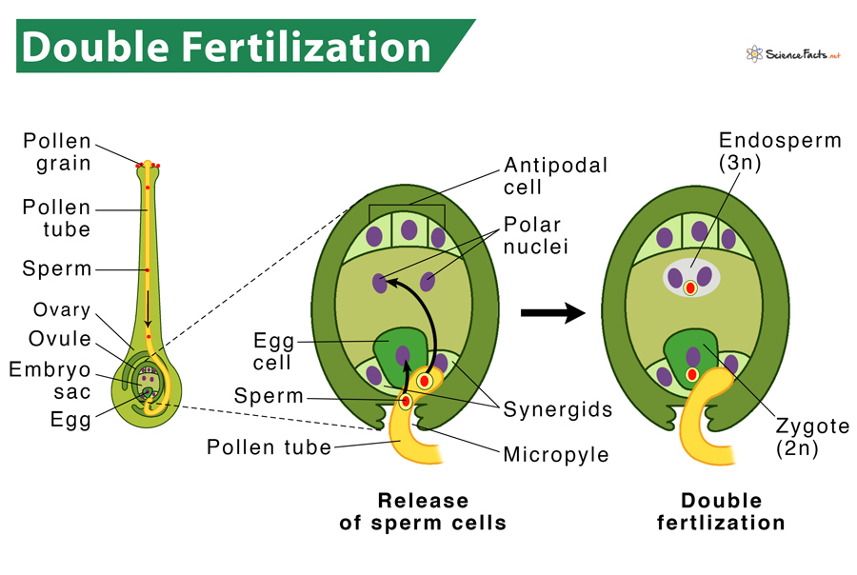
The diploid zygote grows into an embryo, dividing through mitosis. The triploid cell forms the nutritious tissue of the seed, also dividing through mitosis, called the endosperm. Thus, after the double fertilization, the ovule develops into a seed that contains an embryo and the endosperm, surrounded by the integuments that become the seed coat. The ovary develops into a fruit that contains one or more seeds.

Slide 41


